Slide 2

Objective: to capture the IR problem using a probabilistic framework
Given a user query, there is an ideal answer set
Querying as specification of the properties of this ideal answer set (clustering)
But, what are these properties?
Guess at the beginning what they could be (i.e., guess initial description of ideal answer set)
Improve by iteration

Slide 3
Probabilistic Model
An initial set of documents is retrieved somehow
User inspects these docs looking for the relevant ones (in truth, only top 10-20 need to be inspected)
IR system uses this information to refine description of ideal answer set
By repeting this process, it is expected that the description of the ideal answer set will improve
Have always in mind the need to guess at the very beginning the description of the ideal answer set
Description of ideal answer set is modeled in probabilistic terms

Slide 4
Probabilistic model
Asks the question “what is probability that user will see relevant information if they read this document”
  P(rel|di) – probability of relevance after reading di
  How likely is the user to get relevance information from reading this document
  high probability means more likely to get relevant info.

Slide 5
Probability Ranking Principle
Collection of documents
Representation of documents
User uses a query
Representation of query
A set of documents to return
Question: In what order documents to present to user?
Logically: Best document first and then next best and so on
Requirement: A formal way to judge the goodness of documents with respect to query
Possibility: Probability of relevance of the document with respect to query

Slide 6
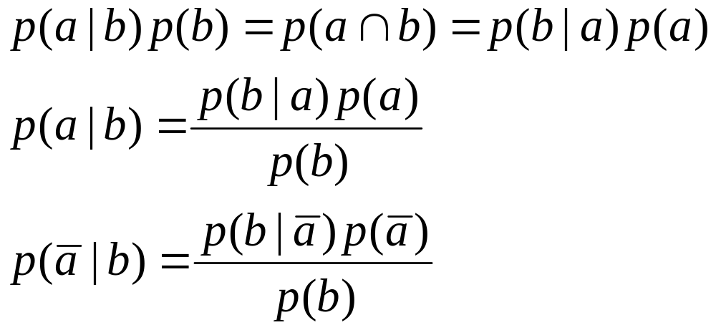
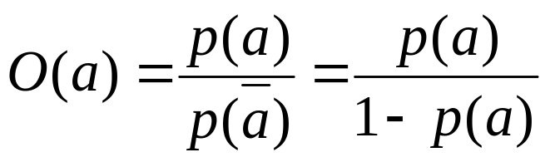
Probability Basics
Bayes’ Rule
Let a and b are two events
Odds of an event a is defined as

Slide 7
Probabilistic Ranking Principle
Given a user query q and a document dj, the probabilistic model tries to estimate the probability that the user will find the document dj interesting (i.e., relevant). The model assumes that this probability of relevance depends on the query and the document representations only. Ideal answer set is referred to as R and should maximize the probability of relevance. Documents in the set R are predicted to be relevant.
But,
  how to compute probabilities?
  what is the sample space?

Slide 8
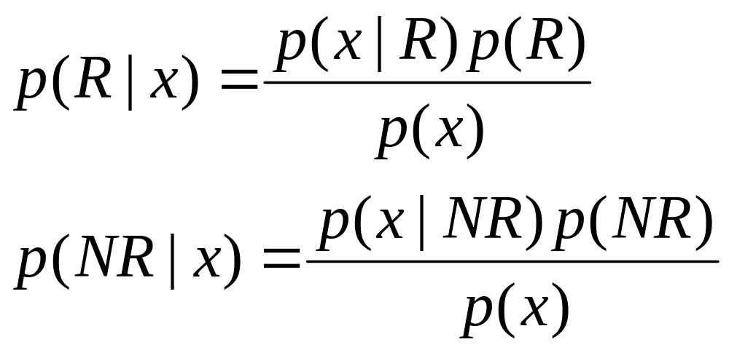
Probability Ranking Principle
Let x be a document in the collection.
Let R represent relevance of a document w.r.t. given (fixed) query and let NR represent non-relevance.
p(R|x) - probability that a retrieved document x is relevant.
p(NR|x) - probability that a retrieved document x is non-relevant.
p(R),p(NR) - prior probability of retrieving a relevant and non-relevant document respectively
p(x|R), p(x|NR) - probability that if a relevant (non-relevant) document is retrieved, it is x.

Slide 9
Probability Ranking Principle
Ranking Principle (Bayes’ Decision Rule):
If p(R|x) > p(NR|x) then x is relevant,
otherwise x is not relevant

Slide 10
Probabilistic model
“if a reference retrieval system's response to each request is a ranking of the documents in the collection in order of decreasing probability of relevance ... the overall effectiveness of the system to its user will be the best that is obtainable…”, Probability ranking principle
  Rank documents based on decreasing probability of relevance to user
  Calculate P(rel|di) for each document and rank
Suggests mathematical approach to IR and matching
  Can predict (somewhat) good retrieval models based on their estimates of P(rel|di)

Slide 11
Probabilistic Models
Most probabilistic models based on combining probabilities of relevance and non-relevance of individual terms
  Probability that a term will appear in a relevant document
  Probability that the term will not appear in a non‐relevant document
These probabilities are estimated based on counting term appearances in document descriptions

Slide 12


Example
Assume we have a collection of 100 documents
  N=100
20 of the documents contain the term sausage
Searcher has read and marked 10 documents as relevant
  R=10
Of these relevant documents 5 contain the term sausage
How important is the word sausage to the searcher?

Slide 13
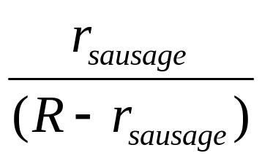


Probability of Relevance
from these four numbers we can estimate probability of sausage given relevance information
  i.e. how important term sausage is to relevant documents
  is number of relevant documents containing sausage (5)
  is number of relevant documents that do not contain sausage (5)
  Eq. (I) is
    higher if most relevant documents contain sausage
    lower if most relevant documents do not contain sausage
    high value means sausage is important term to user in our example (5/5=1)
# of relevant docs which contain sausage
- I
# of relevant docs which don’t contain sausage

Slide 14
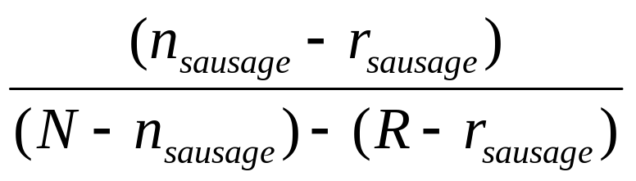
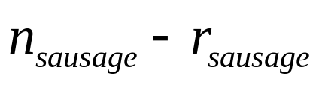
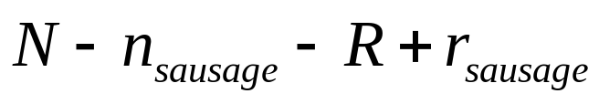
Probability of Non‐relevance
Also we can estimate probability of sausage given non‐relevance information
  i.e. how important term sausage is to non‐relevant documents
is number of non‐relevant documents that contain term sausage (20‐5)=15
is number of non‐relevant documents that do not contain sausage (100‐20‐10+5)=75
# of non-relevant docs which contain sausage
- II
# of docs which don’t contain sausage
# of relevant docs which don’t contain sausage

Slide 15
Eq(II)
  higher if more documents containing term sausage are non‐relevant
  lower if more documents that do not contain sausage are non‐relevant
  low value means sausage is important term to user in our example (15/75=0.2)

Slide 16
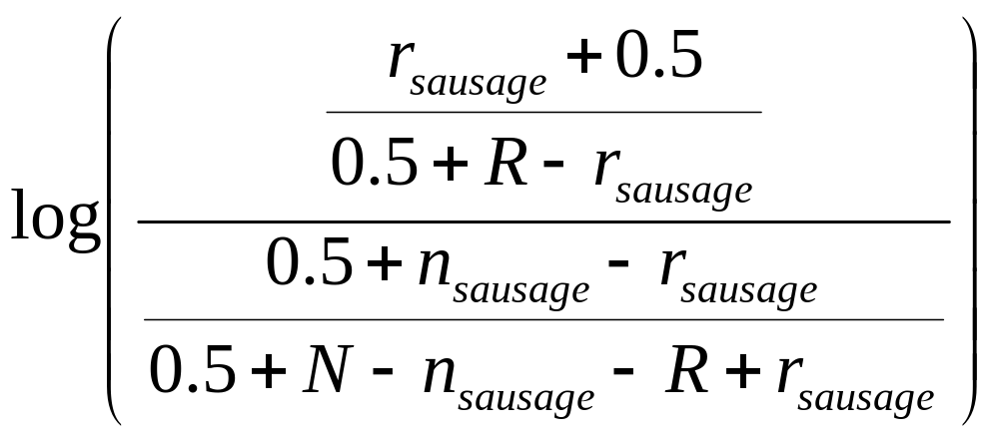
F4 reweighting formula
how important is sausage being present in relevant documents
how important is sausage being absent from non-relevant documents
from example on slide 10 weight of sausage is 5 (1/0.2)

Slide 17
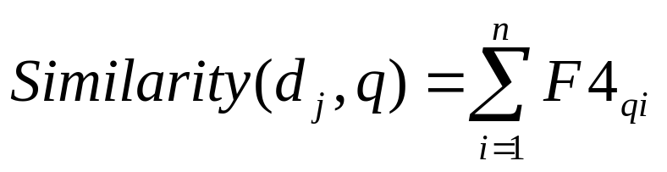
F4 reweighting formula
F4 gives new weights to all terms in collection (or just query)
  high weights to important terms
  Low weights to unimportant terms
  replaces idf, tf, or any other weights
  document score is based on sum of query terms in documents

Slide 18
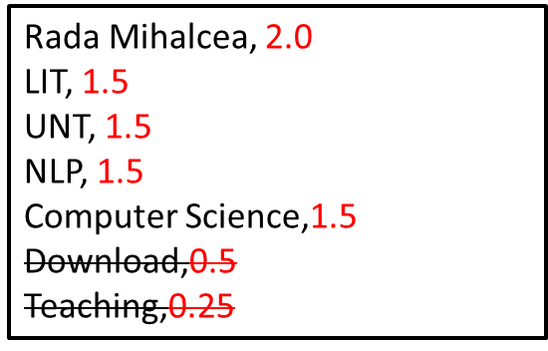
Probabilistic model
can also use to rank terms for addition to query
  rank terms in relevant documents by term reweighting formula
  i.e. by how good the terms are at retrieving relevant documents
    add all terms
    add some, e.g. top 5
in probabilistic formula query expansion and term reweighting done separately
Rada Mihalcea, 1.0

Slide 19
Probabilistic model
Advantages over vector‐space
  Strong theoretical basis
  Based on probability theory (very well understood)
  Easy to extend
Disadvantages
  Models are often complicated
  No term frequency weighting
Which is better vector‐space or probabilistic?
  Both are approximately as good as each other
  Depends on collection, query, and other factors

Slide 20
EXTRA

Slide 22
Fuzzy Set Model
  Q: “gold silver truck”
  D1: “Shipment of gold damaged in a fire”
  D2: “Delivery of silver arrived in a silver truck”
  D3: “Shipment of gold arrived in a truck”
  IDF (Select Keywords)
    a = in = of = 0 = log ^{3/3}
    arrived = gold = shipment = truck = 0.176 = log ^{3/2}
    damaged = delivery = fire = silver = 0.477 = log ^{3/1}
  8 Keywords (Dimensions) are selected
    arrived(1), damaged(2), delivery(3), fire(4), gold(5), silver(6), shipment(7), truck(8)

Slide 23
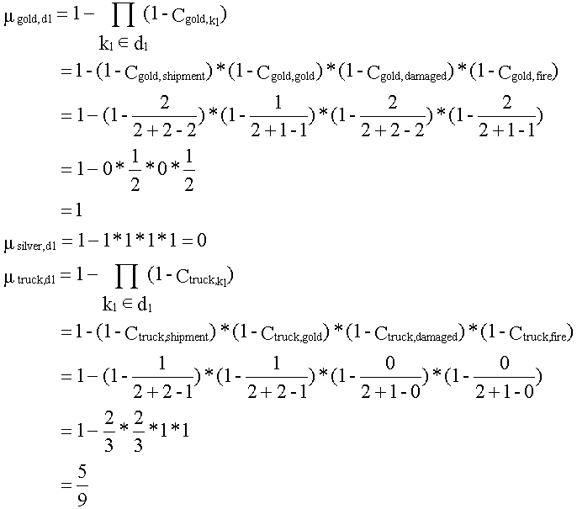
Fuzzy Set Model

Slide 24
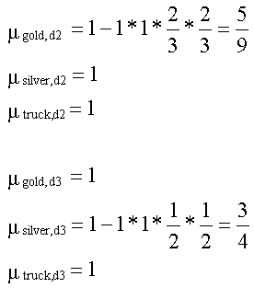
Fuzzy Set Model

Slide 25
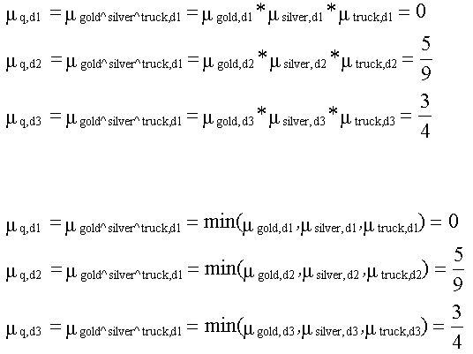
Fuzzy Set Model
Sim(q,d): Alternative 1
Sim(q,d₃) > Sim(q,d₂) > Sim(q,d₁)
Sim(q,d): Alternative 2
Sim(q,d₃) > Sim(q,d₂) > Sim(q,d₁)

Slide 27
Vector Space Model
  Q: “gold silver truck”
  D1: “Shipment of gold damaged in a fire”
  D2: “Delivery of silver arrived in a silver truck”
  D3: “Shipment of gold arrived in a truck”
  8 Dimensions (arrived, damaged, delivery, fire, gold, silver, shipment, truck)
    Weight = TF * IDF
    Q = (0, 0, 0, 0, .176, .477, 0, .176)
    D1 = (0, .477, 0, .477, .176, 0, .176, 0)
    D2 = (.176, 0, .477, 0, 0, .954, 0, .176)
    D3 = (.176, 0, 0, 0, .176, 0, .176, .176)
Construction of
Matrix T

Slide 28
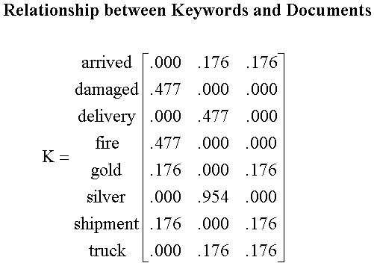
Construction of Matrix T
d1
d2
d3

Slide 29
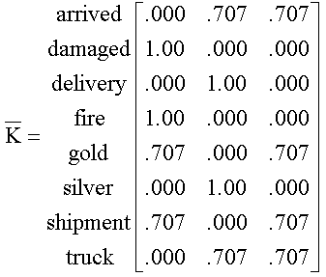
Normalize Matrix K
Normalized Direction

Slide 30
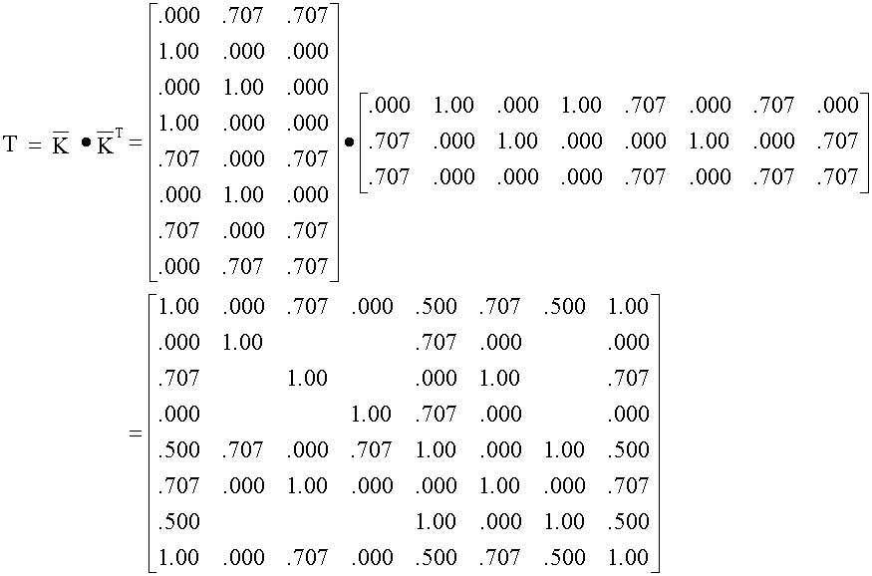
Construction of Matrix T
Calculate by Yourself

